Slide 1


CSB4301 – Theory of Computation
B.Tech – Vth Semester
Converting DFAs into Regular Expressions
Mr. D.S.John Deva Prasanna AP(SG)
Department of Computer Science and Engineering

Slide 2
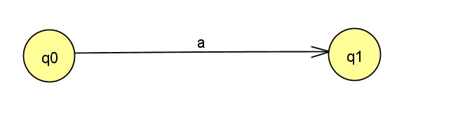
DFA to RE
Every DFA will have an equivalent RE
Strings of RE are the series of input symbols in the automata when we traverse from one state to another through one or more intermediate states.
In this DFA the arc(transition) between from q0 to q1 reads an input ‘a’.
Hence we can say this DFA and the RE ‘a’ are equivalent.

Slide 3
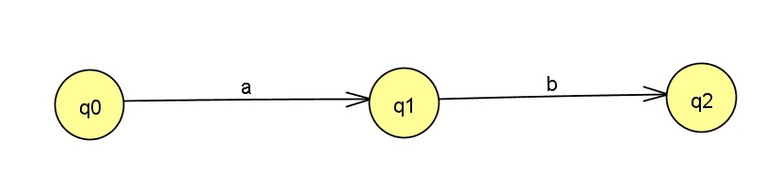
DFA to RE
In the following DFA , the arcs between q0 and q2 includes q0 to q1 and q1 to q2.
This DFA will represent the string ab (a concatenated with b)
Observe the string is obtained by reading the arcs between the states.

Slide 4
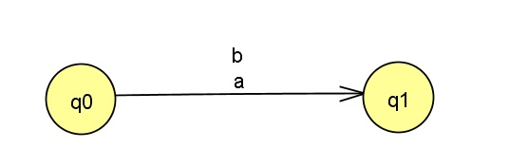
DFA to RE
The following DFA has two paths(two inputs) between q0 and q1
This DFA will represent the string a+b (a or b).
These kind of simple arcs can be extended to accommodate complex DFAs and convert them to RE.

Slide 5
Theorem
If L=L(A) for some DFA A , then there is a RE R such that L=L(R).
We are just trying to prove L(A) and L(R) are same or equivalent.
Suppose A has ‘n’ states {1,2,..n} for some integer n.
The above notation represents the RE obtained by reading the input symbols in arcs running between states ‘i’ and ‘j’.
Here K is the maximum number of the states which are intermediate in the path between ‘i’ and ‘j’.

Slide 6
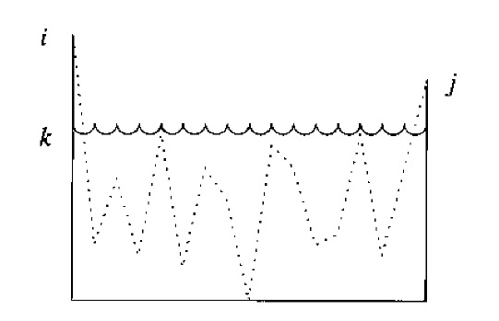
Let us see more about this ‘K’ value
‘i’ and ‘j’ can be more or less than this ‘k’.
The path can pass through the node ‘k’ but cannot pass through a state which is greater than ‘k’.
The below picture represents the k value diagrammatically

Slide 7
We are trying to prove the theorem using induction on this ‘k’
Basis case: K=0
This means there is no intermediate state between node ‘i’ and ‘j’.
There are only two kinds of paths which meets this situation.
A path from node i to j.
A path with only one node ‘i’.
Finding
Now we should read the symbol in the arc between the state.
If there is no such symbol then the is φ.
If there is only one symbol then is ‘a’.
If there are more than one symbol(multiple input) between i and j like a1, a2..an then is a1+a2+..an

Slide 8
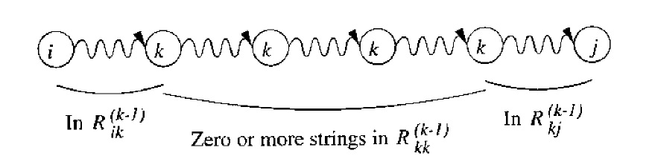
If i=j then the state has a self loop. ()
If the path goes from ‘I’ to ‘j’ without passing through any state labeled more than ‘k’. In this case we have two possibilities.
The path does not goes through the state k
The path goes through ‘k’ at least once. In this case the break the path into three
‘I’ to ‘k’ with out passing through ‘k’
‘k’ to ‘j’
There is a possibility of path has a loop in ‘k’, hence we say the path passes through ‘k’
The resultant RE of all these paths is

Slide 9
The overall RE is
The above formula will be used for deducing the RE from DFA

Slide 10
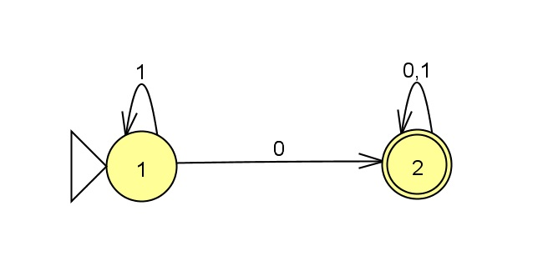
The DFA considered

Slide 11
The substitution of k value as 1 will yield

Slide 12
Contd…
We have to find

Slide 13
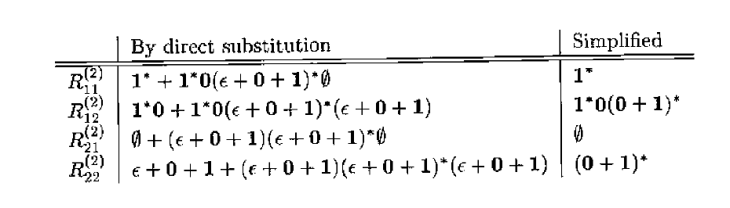

Slide 16
Thank You

